Slide 1
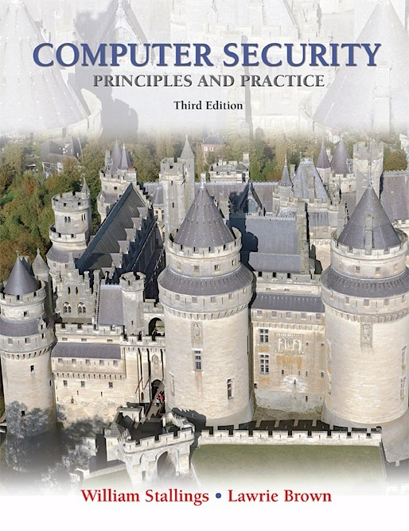
Lecture 10 Cloud Security
modified from slides of Lawrie Brown, Ragib Hasan, YounSun Cho, Anya Kim
Notes:
This chapter looks at the unique security issues that relate to databases.
The focus of this chapter is on relational database management systems
(RDBMS). The relational approach dominates industry, government, and
research sectors and is likely to do so for the foreseeable future. We begin with an
overview of the need for database-specific security techniques. Then we provide
a brief introduction to database management systems, followed by an overview
of relational databases. Next, we look at the issue of database access control,
followed by a discussion of the inference threat. Then we examine security issues
for statistical databases. Next, we examine database encryption. Finally, we
examine the issues raised by the use of cloud technology.

Slide 2
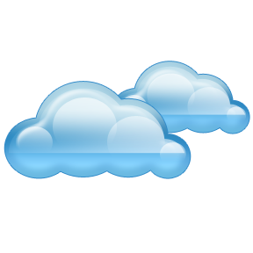
Cloud Computing
NIST defines cloud computing as follows:
“A model for enabling ubiquitous, convenient, on-demand network access to a shared pool of configurable computing resources (e.g., networks, servers, storage, applications, and services) that can be rapidly provisioned and released with minimal management effort or service provider interaction.”
Notes:
There is an increasingly prominent trend in many organizations to move a
substantial portion or even all information technology (IT) operations to an
Internet-connected infrastructure known as enterprise cloud computing. The use
of cloud computing raises a number of security issues, particularly in the area of
database security.
NIST defines cloud computing as follows [MELL11]:
A model for enabling ubiquitous, convenient, on-demand
network access to a shared pool of configurable computing resources (e.g.,
networks, servers, storage, applications, and services) that can be rapidly
provisioned and released with minimal management effort or service provider
interaction. This cloud model promotes availability and is composed of five
essential characteristics, three service models, and four deployment models.

Slide 3
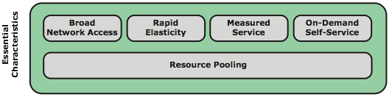
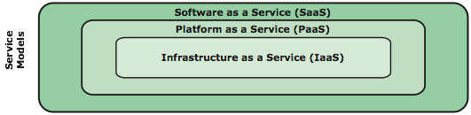
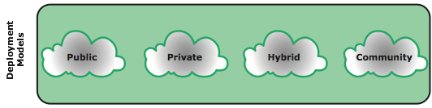
Cloud Computing Elements
Notes:
The definition refers to various models and characteristics, whose relationship is
illustrated in Figure 5.12 . The essential characteristics of cloud computing include
the following:
• Broad network access: Capabilities are available over the network and
accessed through standard mechanisms that promote use by heterogeneous
thin or thick client platforms (e.g., mobile phones, laptops, and PDAs) as well
as other traditional or cloud-based software services.
Rapid elasticity: Cloud computing gives you the ability to expand and
reduce resources according to your specific service requirement. For
example, you may need a large number of server resources for the duration
of a specific task. You can then release these resources upon completion of
the task.
• Measured service: Cloud systems automatically control and optimize
resource use by leveraging a metering capability at some level of abstraction
appropriate to the type of service (e.g., storage, processing, bandwidth, and
active user accounts). Resource usage can be monitored, controlled, and
reported, providing transparency for both the provider and consumer of the
utilized service.
• On-demand self-service: A consumer can unilaterally provision computing
capabilities, such as server time and network storage, as needed automatically
without requiring human interaction with each service provider. Because
the service is on demand, the resources are not permanent parts of your IT
infrastructure.
• Resource pooling: The provider’s computing resources are pooled to serve
multiple consumers using a multi-tenant model, with different physical and
virtual resources dynamically assigned and reassigned according to consumer
demand. There is a degree of location independence in that the customer
generally has no control or knowledge over the exact location of the provided
resources, but may be able to specify location at a higher level of abstraction
(e.g., country, state, or datacenter). Examples of resources include storage,
processing, memory, network bandwidth, and virtual machines. Even
private clouds tend to pool resources between different parts of the same
organization.
NIST defines three service models , which can be viewed as nested service
alternatives:
• Software as a service (SaaS): The capability provided to the consumer is to use
the provider’s applications running on a cloud infrastructure. The applications
are accessible from various client devices through a thin client interface
such as a Web browser. Instead of obtaining desktop and server licenses for
software products it uses, an enterprise obtains the same functions from the
cloud service. SaaS saves the complexity of software installation, maintenance,
upgrades, and patches.
• Platform as a service (PaaS): The capability provided to the consumer
is to deploy onto the cloud infrastructure consumer-created or acquired
applications created using programming languages and tools supported by the
provider. PaaS often provides middleware-style services such as database and
component services for use by applications.
• Infrastructure as a service (IaaS): The capability provided to the consumer is
to provision processing, storage, networks, and other fundamental computing
resources where the consumer is able to deploy and run arbitrary software,
which can include operating systems and applications.
NIST defines four deployment models :
• Public cloud: The cloud infrastructure is made available to the general
public or a large industry group and is owned by an organization selling
cloud services. Both the infrastructure and control of the cloud is with the
service provider.
• Private cloud: The cloud infrastructure is operated solely for an organization.
It may be managed by the organization or a third party and may exist on
premise or off premise. The cloud provider is responsible only for the
infrastructure and not for the control.
• Community cloud: The cloud infrastructure is shared by several organizations
and supports a specific community that has shared concerns (e.g., mission,
security requirements, policy, and compliance considerations). It may be
managed by the organizations or a third party and may exist on premise or
off premise.
• Hybrid cloud: The cloud infrastructure is a composition of two or more
clouds (private, community, or public) that remain unique entities but
are bound together by standardized or proprietary technology that enables
data and application portability (e.g., cloud bursting for load balancing
between clouds).

Slide 4
Notes:
NIST defines three service models , which can be viewed as nested service
alternatives (Figure 5.12):
• Software as a service (SaaS): Provides service to customers in the form of
software, specifically application software, running on and accessible in the
cloud. SaaS follows the familiar model of Web services, in this case applied
to cloud resources. SaaS enables the customer to use the cloud provider’s
applications running on the provider’s cloud infrastructure. The applications
are accessible from various client devices through a simple interface such as
a Web browser. Instead of obtaining desktop and server licenses for software
products it uses, an enterprise obtains the same functions from the cloud service.
SaaS saves the complexity of software installation, maintenance, upgrades, and
patches. Examples of services at this level are Gmail, Google’s e-mail service,
and Salesforce.com, which helps firms keep track of their customers.
• Platform as a service (PaaS): Provides service to customers in the form of
a platform on which the customer’s applications can run. PaaS enables the
customer to deploy onto the cloud infrastructure customer-created or
acquired applications. A PaaS cloud provides useful software building blocks,
plus a number of development tools, such as programming languages, runtime
environments, and other tools that assist in deploying new applications
In effect, PaaS is an operating system in the cloud. PaaS is useful for an
organization that wants to develop new or tailored applications while paying
for the needed computing resources only as needed and only for as long as
needed. Google App Engine and the Salesforce1 Platform from Salesforce.
com are examples of PaaS.
• Infrastructure as a service (IaaS): Provides the customer access to the underlying
cloud infrastructure. IaaS provides virtual machines and other abstracted
hardware and operating systems, which may be controlled through a service
application programming interface (API). IaaS offers the customer processing,
storage, networks, and other fundamental computing resources so that
the customer is able to deploy and run arbitrary software, which can include
operating systems and applications. IaaS enables customers to combine basic
computing services, such as number crunching and data storage, to build highly
adaptable computer systems. Examples of IaaS are Amazon Elastic Compute
Cloud (Amazon EC2) and Windows Azure.

Slide 5
NIST Deployment Models
Public cloud
The cloud infrastructure is made available to the general public or a large industry group and is owned by an organization selling cloud services
The cloud provider is responsible both for the cloud infrastructure and for the control of data and operations within the cloud
Private cloud
The cloud infrastructure is operated solely for an organization
It may be managed by the organization or a third party and may exist on premise or off premise
The cloud provider is responsible only for the infrastructure and not for the control
Community cloud
The cloud infrastructure is shared by several organizations and supports a specific community that has shared concerns
It may be managed by the organizations or a third party and may exist on premise or off premise
Hybrid cloud
The cloud infrastructure is a composition of two or more clouds that remain unique entities but are bound together by standardized or proprietary technology that enables data and application portability
Notes:
NIST defines four deployment models :
• Public cloud: The cloud infrastructure is made available to the general public
or a large industry group and is owned by an organization selling cloud
services. The cloud provider is responsible both for the cloud infrastructure
and for the control of data and operations within the cloud.
• Private cloud: The cloud infrastructure is operated solely for an organization.
It may be managed by the organization or a third party and may exist on
premise or off premise. The cloud provider is responsible only for the
infrastructure and not for the control.
• Community cloud: The cloud infrastructure is shared by several organizations
and supports a specific community that has shared concerns (e.g., mission,
security requirements, policy, and compliance considerations). It may be
managed by the organizations or a third party and may exist on premise or
off premise.
• Hybrid cloud: The cloud infrastructure is a composition of two or more
clouds (private, community, or public) that remain unique entities but
are bound together by standardized or proprietary technology that enables
data and application portability (e.g., cloud bursting for load balancing
between clouds).

Slide 6
Cloud Computing Context
Notes:
Figure 5.13 illustrates the typical cloud service context. An enterprise maintains
workstations within an enterprise LAN or set of LANs, which are connected by
a router through a network or the Internet to the cloud service provider. The cloud
service provider maintains a massive collection of servers, which it manages with a
variety of network management, redundancy, and security tools. In the figure, the cloud
infrastructure is shown as a collection of blade servers, which is a common architecture.

Slide 7
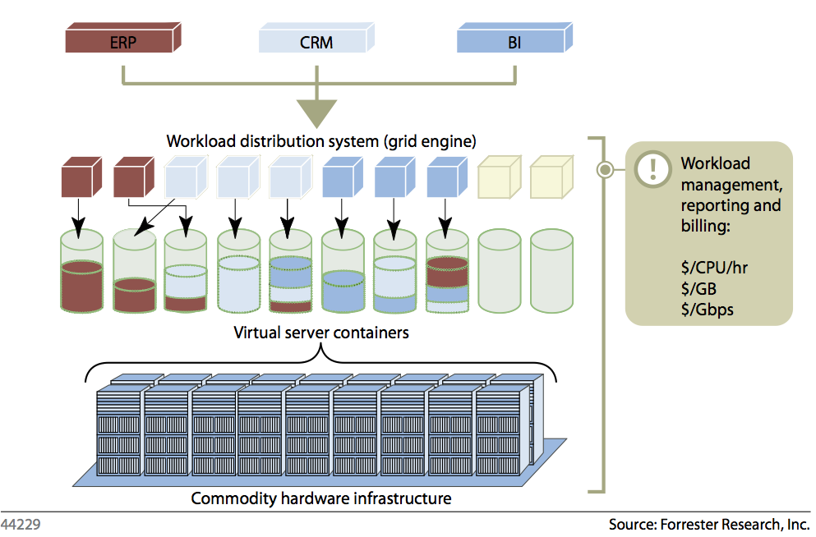
Cloud Fundamentals

Slide 8
Notes:
The reference architecture, depicted in Figure 5.14, defines five major actors
in terms of the roles and responsibilities:
• Cloud consumer: A person or organization that maintains a business relationship
with, and uses service from, cloud providers.
• Cloud provider (CP): A person, organization, or entity responsible for making
a service available to interested parties.
• Cloud auditor: A party that can conduct independent assessment of cloud
services, information system operations, performance, and security of the
cloud implementation.
• Cloud broker: An entity that manages the use, performance and delivery of
cloud services, and negotiates relationships between CPs and cloud consumers.
• Cloud carrier: An intermediary that provides connectivity and transport of
cloud services from CPs to cloud consumers.
The roles of the cloud consumer and provider have already been discussed. To
summarize, a cloud provider can provide one or more of the cloud services to meet
IT and business requirements of cloud consumers . For each of the three service
models (SaaS, PaaS, and IaaS), the CP provides the storage and processing facilities
needed to support that service model, together with a cloud interface for cloud
service consumers. For SaaS, the CP deploys, configures, maintains, and updates the
operation of the software applications on a cloud infrastructure so that the services
are provisioned at the expected service levels to cloud consumers. The consumers
of SaaS can be organizations that provide their members with access to software
applications, end users who directly use software applications, or software application
administrators who configure applications for end users.
For PaaS, the CP manages the computing infrastructure for the platform and
runs the cloud software that provides the components of the platform, such as runtime
software execution stack, databases, and other middleware components. Cloud
consumers of PaaS can employ the tools and execution resources provided by CPs to
develop, test, deploy, and manage the applications hosted in a cloud environment.
For IaaS, the CP acquires the physical computing resources underlying the
service, including the servers, networks, storage, and hosting infrastructure. The
IaaS cloud consumer in turn uses these computing resources, such as a virtual computer,
for their fundamental computing needs.
The cloud carrier is a networking facility that provides connectivity and transport
of cloud services between cloud consumers and CPs. Typically, a CP will set up
service level agreements (SLAs) with a cloud carrier to provide services consistent
with the level of SLAs offered to cloud consumers, and may require the cloud carrier
to provide dedicated and secure connections between cloud consumers and CPs.
A cloud broker is useful when cloud services are too complex for a cloud consumer
to easily manage. Three areas of support can be offered by a cloud broker:
• Service intermediation: These are value-added services, such as identity management,
performance reporting, and enhanced security.
• Service aggregation: The broker combines multiple cloud services to meet
consumer needs not specifically addressed by a single CP, or to optimize performance
or minimize cost.
• Service arbitrage: This is similar to service aggregation except that the services
being aggregated are not fixed. Service arbitrage means a broker has the flexibility
to choose services from multiple agencies. The cloud broker, for example, can
use a credit-scoring service to measure and select an agency with the best score.
A cloud auditor can evaluate the services provided by a CP in terms of security
controls, privacy impact, performance, and so on. The auditor is an independent
entity that can assure that the CP conforms to a set of standards.

Slide 9
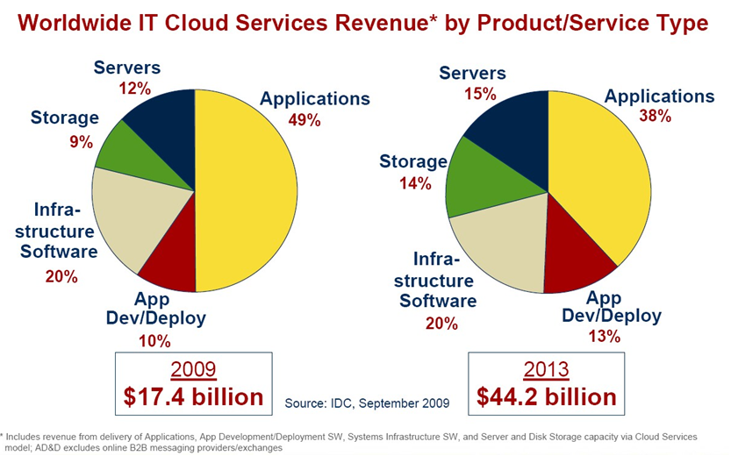
Cloud Distribution Examined

Slide 10
Cloud Security Risks
The Cloud Security Alliance lists the following as the top cloud specific security threats:
abuse and nefarious use of cloud computing
insecure interfaces and APIs
malicious insiders
shared technology issues
data loss or leakage
account or service hijacking
unknown risk profile
Notes:
In general terms, security controls in cloud computing are similar to the security
controls in any IT environment. However, because of the operational models and
technologies used to enable cloud service, cloud computing may present risks that
are specific to the cloud environment. The essential concept in this regard is that
the enterprise loses a substantial amount of control over resources, services, and
applications but must maintain accountability for security and privacy policies.
The Cloud Security Alliance [CSA10] lists the following as the top
cloud-specific security threats:
• Abuse and nefarious use of cloud computing: For many cloud providers
(CPs), it is relatively easy to register and begin using cloud services, some
even offering free limited trial periods. This enables attackers to get inside the
cloud to conduct various attacks, such as spamming, malicious code attacks,
and denial of service. PaaS providers have traditionally suffered most from
this kind of attacks; however, recent evidence shows that hackers have begun
to target IaaS vendors as well. The burden is on the CP to protect against such
attacks, but cloud service clients must monitor activity with respect to their
data and resources to detect any malicious behavior.
Insecure interfaces and APIs: CPs expose a set of software interfaces or APIs
that customers use to manage and interact with cloud services. The security
and availability of general cloud services is dependent upon the security of
these basic APIs. From authentication and access control to encryption and
activity monitoring, these interfaces must be designed to protect against both
accidental and malicious attempts to circumvent policy.
• Malicious insiders: Under the cloud computing paradigm, an organization
relinquishes direct control over many aspects of security and, in doing so,
confers an unprecedented level of trust onto the CP. One grave concern is the
risk of malicious insider activity. Cloud architectures necessitate certain roles
that are extremely high-risk. Examples include CP system administrators and
managed security service providers.
• Shared technology issues: IaaS vendors deliver their services in a scalable
way by sharing infrastructure. Often, the underlying components that make
up this infrastructure (CPU caches, GPUs, etc.) were not designed to offer
strong isolation properties for a multi-tenant architecture. CPs typically
approach this risk by the use of isolated virtual machines for individual clients.
This approach is still vulnerable to attack, by both insiders and outsiders, and
so can only be a part of an overall security strategy.
• Data loss or leakage: For many clients, the most devastating impact from a
security breach is the loss or leakage of data. We address this issue in the next
subsection.
• Account or service hijacking: Account and service hijacking, usually with
stolen credentials, remains a top threat. With stolen credentials, attackers
can often access critical areas of deployed cloud computing services, allowing
them to compromise the confidentiality, integrity, and availability of those
services.
• Unknown risk profile: In using cloud infrastructures, the client necessarily
cedes control to the cloud provider on a number of issues that may affect
security. Thus the client must pay attention to and clearly define the roles
and responsibilities involved for managing risks. For example, employees
may deploy applications and data resources at the CP without observing the
normal policies and procedures for privacy, security, and oversight.
Similar lists have been developed by the European Network and Information
Security Agency [ENIS09] and NIST [JANS11].

Slide 11
Data Protection in the Cloud
the threat of data compromise increases in the cloud
risks and challenges that are unique to the cloud
multi-instance model
provides a unique DBMS running on a virtual machine instance for each cloud subscriber
multi-tenant model
architectural or operational characteristics of the cloud environment
gives the subscriber complete control over administrative tasks related to security
provides a predefined environment for the cloud subscriber that is shared with other tenants typically through tagging data with a subscriber identifier
gives the appearance of exclusive use of the instance but relies on the cloud provider to establish and maintain a secure database environment
Notes:
There are many ways to compromise data. Deletion or alteration of records without
a backup of the original content is an obvious example. Unlinking a record from
a larger context may render it unrecoverable, as can storage on unreliable media.
Loss of an encoding key may result in effective destruction. Finally, unauthorized
parties must be prevented from gaining access to sensitive data.
The threat of data compromise increases in the cloud, due to the number of
and interactions between risks and challenges that are either unique to the cloud or
more dangerous because of the architectural or operational characteristics of the
cloud environment.
Database environments used in cloud computing can vary significantly.
Some providers support a multi-instance model , which provides a unique DBMS
running on a virtual machine instance for each cloud subscriber. This gives the
subscriber complete control over role definition, user authorization, and other
administrative tasks related to security. Other providers support a multi-tenant
model , which provides a predefined environment for the cloud subscriber that
is shared with other tenants, typically through tagging data with a subscriber
identifier. Tagging gives the appearance of exclusive use of the instance, but
relies on the cloud provider to establish and maintain a sound secure database
environment.
Data must be secured while at rest, in transit, and in use, and access to the
data must be controlled. The client can employ encryption to protect data in transit,
though this involves key management responsibilities for the CP. The client can
enforce access control techniques but, again, the CP is involved to some extent
depending on the service model used.
For data at rest, the ideal security measure is for the client to encrypt
the database and only store encrypted data in the cloud, with the CP having no access
to the encryption key. So long as the key remains secure, the CP has no ability to read
the data, although corruption and other denial-of-service attacks remain a risk. The
model depicted in Figure 5.10 works equally well when the data is stored in a cloud.

Slide 12
Cloud Security As A Service
SecaaS
Is a segment of the SaaS offering of a CP
Defined by The Cloud Security Alliance as
the provision of security applications and services via the cloud
either to cloud-based infrastructure and software or from the cloud to the customers’ on-premise systems
Notes:
The term security as a service has generally meant a package of security services
offered by a service provider that offloads much of the security responsibility
from an enterprise to the security service provider. Among the services typically
provided are authentication, anti-virus, antimalware/spyware, intrusion detection,
and security event management. In the context of cloud computing, cloud security
as a service, designated SecaaS, is a segment of the SaaS offering of a CP.
The Cloud Security Alliance defines SecaaS as the provision of security
applications and services via the cloud either to cloud-based infrastructure and
software or from the cloud to the customers’ on-premise systems (Table 5.4)
[CSA11b]. The Cloud Security Alliance has identified the following SecaaS categories
of service:
• Identity and access management
• Data loss prevention
• Web security
• E-mail security
• Security assessments
• Intrusion management
• Security information and event management
• Encryption
• Business continuity and disaster recovery
• Network security

Slide 13
Notes:
In this section, we examine these categories with a focus on security of the
cloud-based infrastructure and services (Figure 5.15).
Identity and access management (IAM) includes people, processes, and systems
that are used to manage access to enterprise resources by assuring that the
identity of an entity is verified, and then granting the correct level of access based
on this assured identity. One aspect of identity management is identity provisioning,
which has to do with providing access to identified users and subsequently deprovisioning,
or denying access, to users when the client enterprise designates such users
as no longer having access to enterprise resources in the cloud. Another aspect of
identity management is for the cloud to participate in the federated identity management
scheme (see Chapter 15) used by the client enterprise. Among other
requirements, the cloud service provider (CSP) must be able to exchange identity
attributes with the enterprise’s chosen identity provider.
The access management portion of IAM involves authentication and access
control services. For example, the CSP must be able to authenticate users in a
trustworthy manner. The access control requirements in SPI environments include
establishing trusted user profile and policy information, using it to control access
within the cloud service, and doing this in an auditable way.
Data loss prevention (DLP) is the monitoring, protecting, and verifying the
security of data at rest, in motion, and in use. Much of DLP can be implemented by
the cloud client, such as discussed in Section 16.6. The CSP can also provide DLP
services, such as implementing rules about what functions can be performed on data
in various contexts.
Web security is real-time protection offered either on premise through software/
appliance installation or via the Cloud by proxying or redirecting Web traffic to
the CP. This provides an added layer of protection on top of things like antiviruses
to prevent malware from entering the enterprise via activities such as Web browsing.
In addition to protecting against malware, a cloud-based Web security service might
include usage policy enforcement, data backup, traffic control, and Web access
control.
A CSP may provide a Web-based e-mail service, for which security measures
are needed. E-mail security provides control over inbound and outbound email,
protecting the organization from phishing, malicious attachments, enforcing corporate
polices such as acceptable use and spam prevention. The CSP may also incorporate
digital signatures on all e-mail clients and provide optional e-mail encryption.
Security assessments are third-part audits of cloud services. While this service
is outside the province of the CSP, the CSP can provide tools and access points to
facilitate various assessment activities.
Intrusion management encompasses intrusion detection, prevention, and
response. The core of this service is the implementation of intrusion detection systems
(IDSs) and intrusion prevention systems (IPSs) at entry points to the cloud
and on servers in the cloud. An IDS is a set of automated tools designed to detect
unauthorized access to a host system. We discuss this in Chapter 21. An IPS incor-
porates IDS functionality but also includes mechanisms designed to block traffic
from intruders.
Security information and event management (SIEM) aggregates (via push or
pull mechanisms) log and event data from virtual and real networks, applications,
and systems. This information is then correlated and analyzed to provide real-time
reporting and alerting on information/events that may require intervention or other
type of response. The CSP typically provides an integrated service that can put
together information from a variety of sources both within the cloud and within the
client enterprise network.
Encryption is a pervasive service that can be provided for data at rest in the
cloud, e-mail traffic, client-specific network management information, and identity
information. Encryption services provided by the CSP involve a range of complex
issues, including key management, how to implement virtual private network
(VPN) services in the cloud, application encryption, and data content access.
Business continuity and disaster recovery comprise measures and mechanisms
to ensure operational resiliency in the event of any service interruptions.
This is an area where the CSP, because of economies of scale, can offer obvious
benefits to a cloud service client [WOOD10]. The CSP can provide backup
at multiple locations, with reliable failover and disaster recovery facilities. This
service must include a flexible infrastructure, redundancy of functions and hardware,
monitored operations, geographically distributed data centers, and network
survivability.
Network security consists of security services that allocate access, distribute,
monitor, and protect the underlying resource services. Services include perimeter
and server firewalls and denial-of-service protection. Many of the other services
listed in this section, including intrusion management, identity and access management,
data loss protection, and Web security, also contribute to the network security
service.

Slide 14

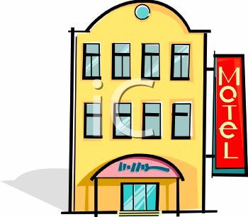
Traditional systems security vs Cloud Computing Security
Analogy
Securing a house
Securing a motel
Owner and user are often the same entity
Owner and users are almost invariably distinct entities

Slide 15
Traditional systems security vs Cloud Computing Security
Securing a house
Securing a motel
Biggest user concerns
Securing perimeter
Checking for intruders
Securing assets
Biggest user concern
Securing room against (the bad guy in next room | hotel owner)

Slide 16
Who is the attacker?
Insider?
Malicious employees at client
Malicious employees at Cloud provider
Cloud provider itself
Outsider?
Intruders
Network attackers?

Slide 17
Attacker Capability: Malicious Insiders
At client
Learn passwords/authentication information
Gain control of the VMs
At cloud provider
Log client communication

Slide 18
Attacker Capability: Cloud Provider
What?
Can read unencrypted data
Can possibly peek into VMs, or make copies of VMs
Can monitor network communication, application patterns

Slide 19
Attacker motivation: Cloud Provider
Why?
Gain information about client data
Gain information on client behavior
Sell the information or use itself
Why not?
Cheaper to be honest?
Why? (again)
Third party clouds?

Slide 20
Attacker Capability: Outside attacker
What?
Listen to network traffic (passive)
Insert malicious traffic (active)
Probe cloud structure (active)
Launch DoS

Slide 21
Novel attacks on clouds
Question: Can you attack a cloud or other users, without violating any law?
Answer: Yes!! By launching side channel attacks, while not violating Acceptable User Policy.
A Side Channel is a passive attack in which attacker gains information about target through indirect observations.

Slide 22
Why Cloud Computing brings new threats?
Traditional system security mostly means keeping bad guys out
The attacker needs to either compromise the auth/access control system, or impersonate existing users

Slide 23
Why Cloud Computing brings new threats?
But clouds allow co-tenancy :
Multiple independent users share the same physical infrastructure
So, an attacker can legitimately be in the same physical machine as the target

Slide 24

Challenges for the attacker
How to find out where the target is located
How to be co-located with the target in the same (physical) machine
How to gather information about the target

Slide 25
More on attacks…
Can one determine where in the cloud infrastructure an instance is located?
Can one easily determine if two instances are co-resident on the same physical machine?
Can an adversary launch instances that will be co-resident with other user instances?
Can an adversary exploit cross-VM information leakage once co-resident?
Answer: Yes to all

Slide 26
Cloud Cartography Strategy
Map the cloud infrastructure to find where the target is located
Use various heuristics to determine co-residency of two VMs
Launch probe VMs trying to be co-resident with target VMs
Exploit cross-VM leakage to gather info about target
Hey, You, Get Off of My Cloud: Exploring Information Leakage in Third-Party Compute Clouds, Ristenpart et al., CCS 2009

Slide 27
Clouds extend the attack surface
An attack surface is a vulnerability in a system that malicious users may utilize
How?
By requiring users to communicate with the cloud over a public / insecure network
By sharing the infrastructure among multiple users

Slide 28
Analyzing Attack Surfaces in Clouds
Cloud attack surfaces can be modeled using a 3 entity model (user, service, cloud)
Figure from: Gruschka et al., Attack Surfaces: A Taxonomy for Attacks on Cloud Services.

Slide 29
Attack Surface: 1
Service interface exposed towards clients
Possible attacks: Common attacks in client-server architectures
E.g., Buffer overflow, SQL injection, privilege escalation

Slide 30
Attack Surface: 2
User exposed to the service
Common attacks
E.g., SSL certificate spoofing, phishing

Slide 31
Attack Surface: 3
Cloud resources/interfaces exposed to service
Attacks run by service on cloud infrastructure
E.g., Resource exhaustion, DoS

Slide 32
Attack Surface: 4
Service interface exposed to cloud
Privacy attack
Data integrity attack
Data confidentiality attack

Slide 33
Attack Surface: 5
Cloud interface exposed to users
Attacks on cloud control

Slide 34
Attack Surface: 6
User exposed to cloud
How much the cloud can learn about a user?

Slide 35
Problems Associated with Cloud Computing
Most security problems stem from:
Loss of control
Lack of trust (mechanisms)
Multi-tenancy
These problems exist mainly in 3rd party management models
Self-managed clouds still have security issues, but not related to above
Notes:
35
Data mobility: the ability to share data between cloud services
Where does data reside?
- out-of-state, out-of-country issues
Security Concerns for government in particular
FISMA
How to certify and accredit cloud computing providers under FISMA
(e.g. ISO 27001)

Slide 36
Loss of Control in the Cloud
Consumer’s loss of control
Data, applications, resources are located with provider
User identity management is handled by the cloud
User access control rules, security policies and enforcement are managed by the cloud provider
Consumer relies on provider to ensure
Data security and privacy
Resource availability
Monitoring and repairing of services/resources

Slide 37
Lack of Trust in the Cloud
Trusting a third party requires taking risks
Defining trust and risk
Opposite sides of the same coin (J. Camp)
People only trust when it pays (Economist’s view)
Need for trust arises only in risky situations
Defunct third party management schemes
Hard to balance trust and risk
e.g. Key Escrow (Clipper chip)
Is the cloud headed toward the same path?
Notes:
Chiles and McMakin (1996) define trust as increasing one’s vulnerability to the risk of opportunistic behavior of another whose behavior is not under one’s control in a situation in which the costs of violating the trust are greater than the benefits of upholding the trust.
Trust here means mostly lack of accountability and verifiability

Slide 38
Multi-tenancy Issues in the Cloud
Conflict between tenants’ opposing goals
Tenants share a pool of resources and have opposing goals
How does multi-tenancy deal with conflict of interest?
Can tenants get along together and ‘play nicely’ ?
If they can’t, can we isolate them?
How to provide separation between tenants?
Cloud Computing brings new threats
Multiple independent users share the same physical infrastructure
Thus an attacker can legitimately be in the same physical machine as the target
Notes:
Who are my neighbors? What is their objective? They present another facet of risk and trust requirements

Slide 39
Cloud Security Issues
Confidentiality
Fear of loss of control over data
Will the sensitive data stored on a cloud remain confidential?
Will cloud compromises leak confidential client data
Will the cloud provider itself be honest and won’t peek into the data?
Integrity
How do I know that the cloud provider is doing the computations correctly?
How do I ensure that the cloud provider really stored my data without tampering with it?

Slide 40
Cloud Security Issues (cont.)
Availability
Will critical systems go down at the client, if the provider is attacked in a Denial of Service attack?
What happens if cloud provider goes out of business?
Would cloud scale well-enough?
Often-voiced concern
Although cloud providers argue their downtime compares well with cloud user’s own data centers

Slide 41
Cloud Security Issues (cont.)
Privacy issues raised via massive data mining
Cloud now stores data from a lot of clients, and can run data mining algorithms to get large amounts of information on clients
Increased attack surface
Entity outside the organization now stores and computes data, and so
Attackers can now target the communication link between cloud provider and client
Cloud provider employees can be phished

Slide 42
Cloud Security Issues (cont.)
Auditability and forensics (out of control of data)
Difficult to audit data held outside organization in a cloud
Forensics also made difficult since now clients don’t maintain data locally
Legal dilemma and transitive trust issues
Who is responsible for complying with regulations?
e.g., SOX, HIPAA, GLBA ?
If cloud provider subcontracts to third party clouds, will the data still be secure?

Slide 43

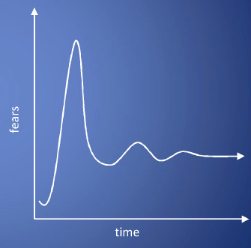
Cloud Security Issues (cont.)
Cloud Computing is a security nightmare and it can't be handled in traditional ways.
John Chambers
CISCO CEO
Security is one of the most difficult task to implement in cloud computing.
Different forms of attacks in the application side and in the hardware components
Attacks with catastrophic effects only needs one security flaw

Slide 44
Possible Solutions

Slide 45
Minimize Lack of Trust: Policy Language
Consumers have specific security needs but don’t have a say-so in how they are handled
Currently consumers cannot dictate their requirements to the provider (SLAs are one-sided)
Standard language to convey one’s policies and expectations
Agreed upon and upheld by both parties
Standard language for representing SLAs
Create policy language with the following characteristics:
Machine-understandable (or at least processable),
Easy to combine/merge and compare
Notes:
These SLAs typically state the high level policies of the provider (e.g. Will maintain uptime of 98%) and do not allow cloud consumers to dictate their requirements to the provider. COI clouds in particular have specific security policy requirements that must be met by the provider, due to the nature of COIs and the missions they are used for. These requirements need to be communicated to the provider and the provider needs to provide some way of stating that the requirements can be met. Cloud consumers and providers need a standard way of representing their security requirements and capabilities. Consumers also need a way to verify that the provided infrastructure and its purported security mechanisms meet the requirements stated in the consumer’s policy (proof of assertions). For example, if the consumer’s policy requires isolation of VMs, the provider can create an assertion statement that says it uses cache separation to support VM isolation.

Slide 46
Minimize Lack of Trust: Certification
Certification
Some form of reputable, independent, comparable assessment and description of security features and assurance
Sarbanes-Oxley, DIACAP, DISTCAP, etc
Risk assessment
Performed by certified third parties
Provides consumers with additional assurance

Slide 47
Minimize Loss of Control: Monitoring
Cloud consumer needs situational awareness for critical applications
When underlying components fail, what is the effect of the failure to the mission logic
What recovery measures can be taken
by provider and consumer
Requires an application-specific run-time monitoring and management tool for the consumer
The cloud consumer and cloud provider have different views of the system
Enable both the provider and tenants to monitor the components in the cloud that are under their control
Notes:
When the underlying components fail in the cloud, the effect of the failures to the mission logic needs to be known so that correct recovery measures can be performed. We propose an application-specific run-time monitoring and management tool. With this tool, the application logic can remain on the consumer’s host computer. This allows the consumer to centrally monitor all aspects of the application as well as data flow. Since all outputs from underlying services are sent to the application logic, any data incompatibility between services is not an issue. The capabilities of the run-time monitoring and management tool are as follows: 1) Enable application user to determine the status of the cloud resources that may be used to run the application (across multiple clouds), 2) Enable application user to determine the real-time security posture and situational awareness of the application, 3) Provide the application user with the ability to move user’s application (or part of it) to another site (other VM in same cloud or different cloud altogether), 4) Provide the application user with the ability to change the application logic on the fly, 5) Provide communicate capabilities with cloud providers. There are a few cloud vendors such as NimSoft [41] and Hyperic [42] that provide application-specific monitoring tools that provide some of the above functionality. These monitoring tools may be further enhanced or used in conjunction with other tools to provide the degree of monitoring required. However, any tool that is to be used for military purposes must also receive some type of accreditation and certification procedure.

Slide 48
Minimize Loss of Control: Monitoring
Provide mechanisms that enable the provider to act on attacks he can handle.
infrastructure remapping
create new or move existing fault domains
shutting down offending components or targets
and assisting tenants with porting if necessary
Repairs
Provide mechanisms that enable the consumer to act on attacks that he can handle
application-level monitoring
RAdAC (Risk-adaptable Access Control)
VM porting with remote attestation of target physical host
Provide ability to move the user’s application to another cloud

Slide 49
Minimize Loss of Control: Utilize Different Clouds
The concept of ‘Don’t put all your eggs in one basket’
Consumer may use services from different clouds through an intra-cloud or multi-cloud architecture
A multi-cloud or intra-cloud architecture in which consumers
Spread the risk
Increase redundancy (per-task or per-application)
Increase chance of mission completion for critical applications
Possible issues to consider:
Policy incompatibility (combined, what is the overarching policy?)
Data dependency between clouds
Differing data semantics across clouds
Knowing when to utilize the redundancy feature
monitoring technology
Is it worth it to spread your sensitive data across multiple clouds?
Redundancy could increase risk of exposure
Notes:
Differering data semantics example: does a data item labeled secret in one cloud have the same semantics as another piece of data also labeled secret in a different cloud?

Slide 50
Minimize Loss of Control: Access Control
Many possible layers of access control
E.g. access to the cloud, access to servers, access to services, access to databases (direct and queries via web services), access to VMs, and access to objects within a VM
Depending on the deployment model used, some of these will be controlled by the provider and others by the consumer
Regardless of deployment model, provider needs to manage the user authentication and access control procedures (to the cloud)
Federated Identity Management: access control management burden still lies with the provider
Requires user to place a large amount of trust on the provider in terms of security, management, and maintenance of access control policies.
This can be burdensome when numerous users from different organizations with different access control policies, are involved
Notes:
In cloud computing (as well as other systems), there are many possible layers of access control. For example, access to the cloud, access to servers, access to services, access to databases (direct and queries via web services), access to VMs, and access to objects within a VM. Depending on the deployment model used, some of these will be controlled by the provider and others by the consumer.
For example, Google Apps, a representative SaaS Cloud controls authentication and access to its applications, but users themselves can control access to their documents through the provided interface to the access control mechanism. In IaaS type approaches, the user can create accounts on its virtual machines and create access control lists for these users for services located on the VM.
Regardless of the deployment model, the provider needs to manage the user authentication and access control procedures (to the cloud). While some providers allow federated authentication – enabling the consumer-side to manage its users, the access control management burden still lies with the provider. This requires the user to place a large amount of trust on the provider in terms of security, management, and maintenance of access control policies. This can be burdensome when numerous users from different organizations with different access control policies, are involved. This proposal focuses on access control to the cloud. However, the concepts here could be applied to access control at any level, if deemed necessary. We propose a way for the consumer to manage the access control decision-making process to retain some control, requiring less trust of the provider.
Approach:
This approach requires the client and provider to have a pre-existing trust relationship, as well as a pre-negotiated standard way of describing resources, users, and access decisions between the cloud provider and consumer. It also needs to be able to guarantee that the provider will uphold the consumer-side’s access decisions. Furthermore, we need to show that this approach is at least as secure as the traditional access control model.
This approach requires the data owner to be involved in all requests. Therefore, frequent access scenarios should not use this method if traffic is a concern. However, many secure data outsourcing schemes require the user to grant keys/certificates to the query side, so that every time the user queries a database, the owner needs to be involved. Therefore, not much different than that so may not be a problem.

Slide 51
Minimize Loss of Control: Access Control
Consumer-managed access control
Consumer retains decision-making process to retain some control, requiring less trust of the provider
Requires the client and provider to have a pre-existing trust relationship, as well as a pre-negotiated standard way of describing resources, users, and access decisions between the cloud provider and consumer.
It also needs to be able to guarantee that the provider will uphold the consumer-side’s access decisions.
Should be at least as secure as the traditional access control model.

Slide 52
Minimize Loss of Control: Access Control
Cloud Provider in Domain A
Cloud Consumer in Domain B
Identity
Provider
1. Authn request
IDP
Policy
Enforcement
Point
(intercepts all
resource
access requests
from all client
domains)
3. Resource request (XACML Request) + SAML assertion
2. SAML Assertion
.
.
.
4. Redirect to domain of resource owner
Policy
Decision
Point
for cloud
resource
on Domain A
5. Retrieve policy
for specified resource
resources
ACM
(XACML
policies)
7. Send signed and encrypted ticket
6. Determine whether user can access
specified resource
7. Create ticket for grant/deny
8. Decrypt and verify signature
9. Retrieve capability from ticket
10. Grant or deny access based on capability
Security Assertion Markup Language
eXtensible Access Control Markup Language

Slide 53
Minimize Multi-tenancy
Can’t really force the provider to accept less tenants
Can try to increase isolation between tenants
Strong isolation techniques (VPC to some degree)
QoS requirements need to be met
Policy specification
Can try to increase trust in the tenants
Who’s the insider, where’s the security boundary? Who can I trust?
Use SLAs to enforce trusted behavior

Slide 54
Conclusion
Cloud computing is sometimes viewed as a reincarnation of the classic mainframe client-server model
However, resources are ubiquitous, scalable, highly virtualized
Contains all the traditional threats, as well as new ones
In developing solutions to cloud computing security issues it may be helpful to identify the problems and approaches in terms of
Loss of control
Lack of trust
Multi-tenancy problems

